Slide 1
PROGRESS MADE TOWARDS AICHI’S TARGETS
GROUP 21

Slide 2
OUTLINE
Introduction
Progress Made Towards Aichi’s Target
Challenges Faced In Achieving Aichi’s Targets
The Way Forward
Post 2020 Global Biodiversity
The Role Of Stakeholders And Global corporation
Conclusion

Slide 3
INTRODUCTION
The Aichi’s targets are a set of 20 strategic goals established by the Convention on Biological Diversity (CBD) during their 10th meeting in Nagoya, Japan .
These targets are crucial as they aim to address biodiversity crises including biodiversity loss and promotes the sustainable use of natural resources.
The Aichi’s target was set to be achieved within a 10-year frame, thus from 2011- 2020.

Slide 4
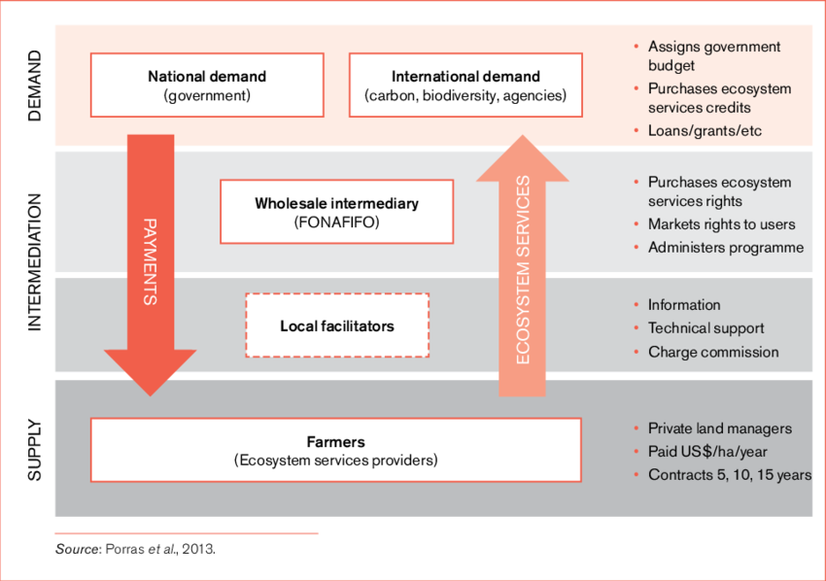
PROGRESS MADE TOWARDS AICHI'S TARGET: MET TARGETS
Target 1- Expansion of protected areas: Costa Rica has made remarkable progress in expanding its protected areas by the establishment of its PES program.
Structure of Costa Rica’s PES programme

Slide 5
PROGRESS MADE TOWARDS AICHI'S TARGET: MET TARGETS
Target 15 - Ecosystem restoration initiatives: Restoration efforts include reforestation, habitat restoration and the rehabilitation of degraded ecosystems.
The Atlantic forest restoration in brazil is an example of this initiative and aims to restore 15 million hectares of the Atlantic forest by 2050.

Slide 6
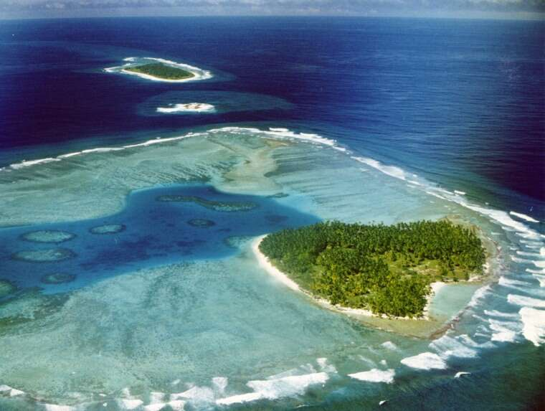
PROGRESS MADE TOWARDS AICHI'S TARGET: MET TARGETS
Target 11- Expansion of marine protected areas: Countries like the UK has achieved a significant success in achieving this target by designing the Chargo’s Archipelago, a vast marine protected area in the Indian ocean, covering over 640, 000 sq. kilometers.
The Chargo’s Archipelago

Slide 7
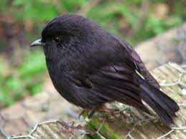
PROGRESS MADE TOWARDS AICHI'S TARGET: PARTIALLY MET TARGETS
Target 12 - Conservation of threatened species: Efforts to conserve threatened species have yielded positive results .
Example: In new Zealand, the successful conservation of the Petroica traversi saved them from extinction.
Petroica traversi

Slide 8
PROGRESS MADE TOWARDS AICHI'S TARGET: UNMET TARGETS
Target 5 - Reduction of habitat loss : Increased demand for agriculture, urbanization and infrastructure development.
Target 10 - Sustainable use of fisheries: Inadequate enforcement of fishing regulations, insufficient monitoring, lack of capacity to address illegal mining .

Slide 9
CHALLENGES FACED IN ACHIEVING AICHI'S TARGETS
Habitat loss and degradation
Overexploitation of natural resources
Lack of adequate funding and resources
Limited technological capacity
Urbanization
Lack of political will

Slide 10
THE WAY FORWARD
Strengthening policy ad legal framework legacy
Enhanced monitoring and reporting
Incentive mechanisms
Empowering local communities
Development planning

Slide 11
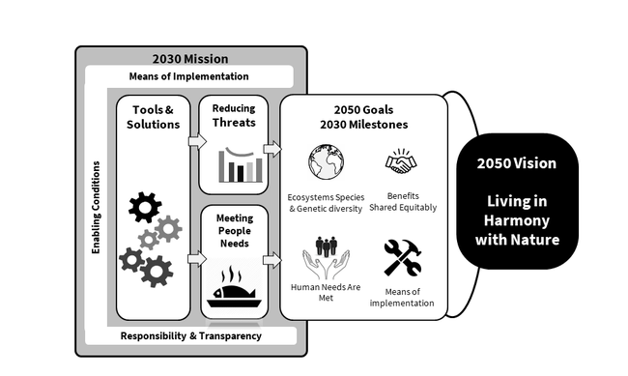
POST 2020 GLOBAL BIODIVERSITY FRAMEWORK
A new strategic plan being developed by the CBD to succeed the Aichi’s biodiversity target.
The development of this target is as a response to the recognition that the Aichi’s targets were not fully achieved and that urgent and more comprehensive action is needed to halt biodiversity loss.
Post 2020 Global Biodiversity framework

Slide 12
POST 2020 GLOBAL BIODIVERSITY FRAMEWORK
The post 2020 global biodiversity framework includes key features and improvements such as:
Enhanced ambition
Integrated approach
Inclusivity and participation
Mainstreaming biodiversity

Slide 13
THE ROLE OF STAKEHOLDERS AND GLOBAL COOPERATION
Collaboration among government NGO’s, businesses and local communities is crucial for achieving biodiversity goals effectively and sustainably.
Successful collaborations that contributed to the Aichi’s target include debt for nature swaps, conservation partnerships, initiatives like the Global Environment Facility, and corporative efforts of the Coral Triangle.

Slide 14
CONCLUSION
Biodiversity conservation remains our utmost concern due to its critical role in sustaining ecosystems and human wellbeing.
The Post 2020 Global Biodiversity Framework provides an opportunity to strengthen commitments and set ambiguous goals such that renewed efforts can halt biodiversity loss, conserve threatened species and restore ecosystems for the benefit of present and future generations.

Slide 15
REFERENCES
Post-2020 Global Biodiversity Framework (cbd.int)
Buchanan, G. M., Butchart, S. H., Chandler, G., & Gregory, R. D. (2020). Assessment of national-level progress towards elements of the Aichi Biodiversity Targets. Ecological Indicators, 116, 106497.
Han, X., Smyth, R. L., Young, B. E., Brooks, T. M., Sánchez de Lozada, A., Bubb, P., ... & Turner, W. R. (2014). A biodiversity indicators dashboard: Addressing challenges to monitoring progress towards the Aichi biodiversity targets using disaggregated global data. PLoS One, 9(11), e112046.
Gannon, P., Dubois, G., Dudley, N., Ervin, J., Ferrier, S., Gidda, S., ... & Shestakov, A. (2019). Editorial Essay: An update on progress towards Aichi biodiversity target 11. Parks, 25(2), 7-18.
cbd.int/doc/publications/cbd-ts-78-en.pdf
Enhancing progress towards Aichi Target 11 | IUCN

Slide 16
Thank you.

